Slide 1
Hamilton County School District
Teacher Lead Network Ceremony
February 23rd, 2023

Slide 2
FOLLOW US ON TWITTER
#hamcotln

Slide 3
Two In-School Tutors Are Needed
15 Hours Per Week
$35 Per Hour
Inquire Today!
This Photo by Unknown Author is licensed under CC BY

Slide 4
Our Teacher Lead Network Website:
www.hamiltonfl.com/tln

Slide 5
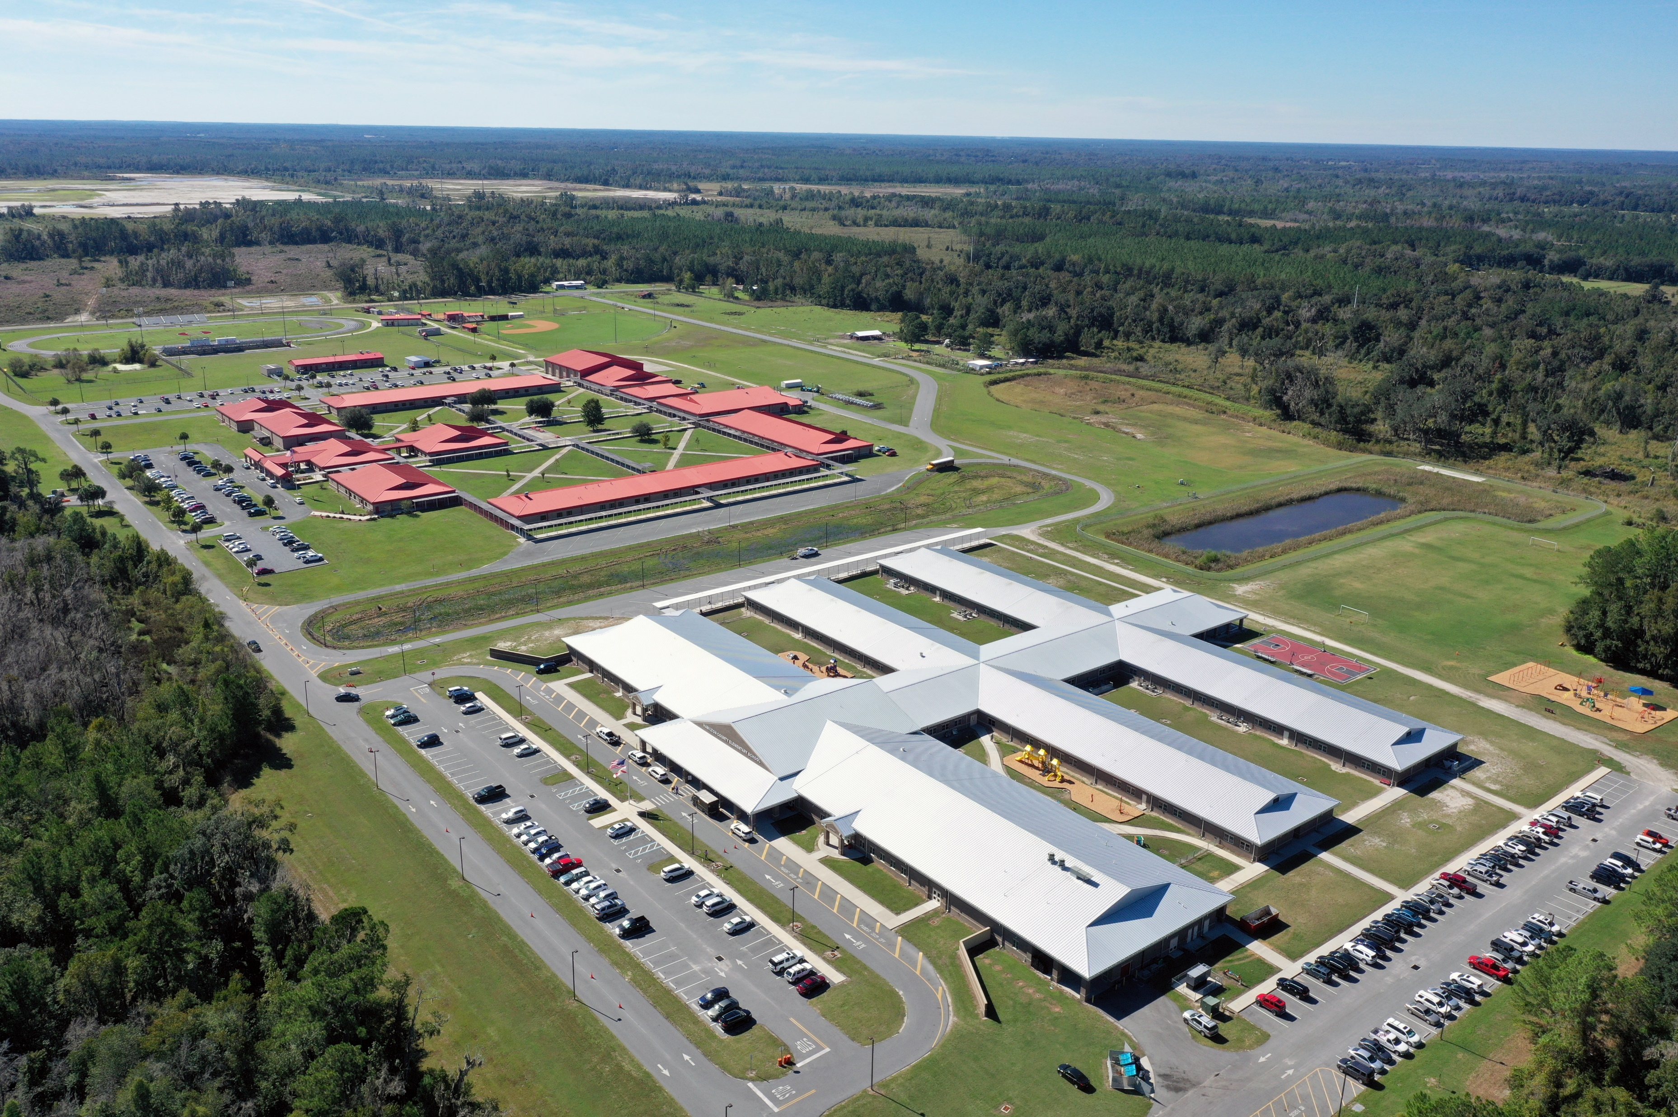
Hamilton County School District

Slide 6
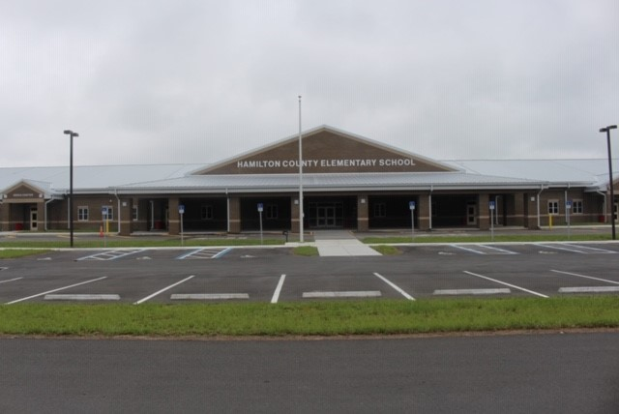
Hamilton County Elementary School

Slide 7
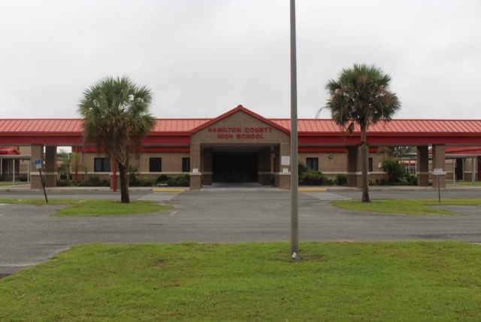
Hamilton County High School

Slide 8
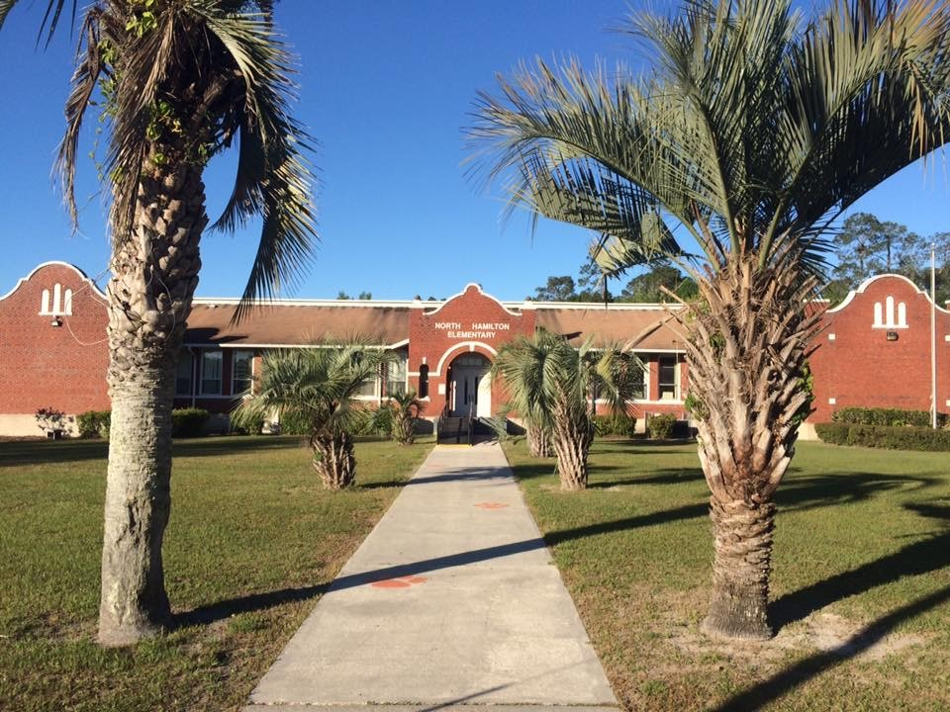
A Trip Down Memory Lane

Slide 9
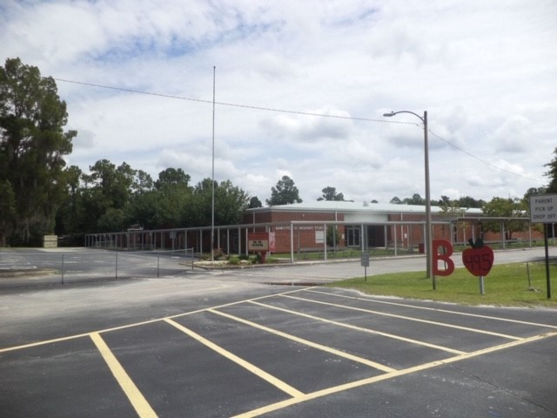
A Trip Down Memory Lane

Slide 10
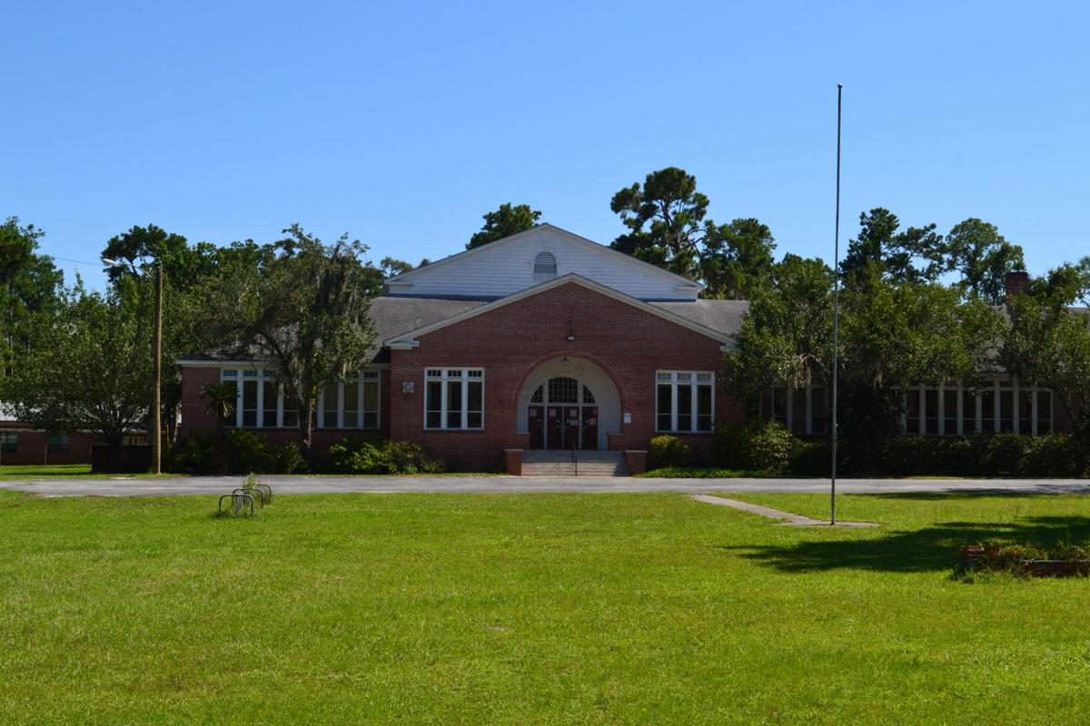
A Trip Down Memory Lane

Slide 11
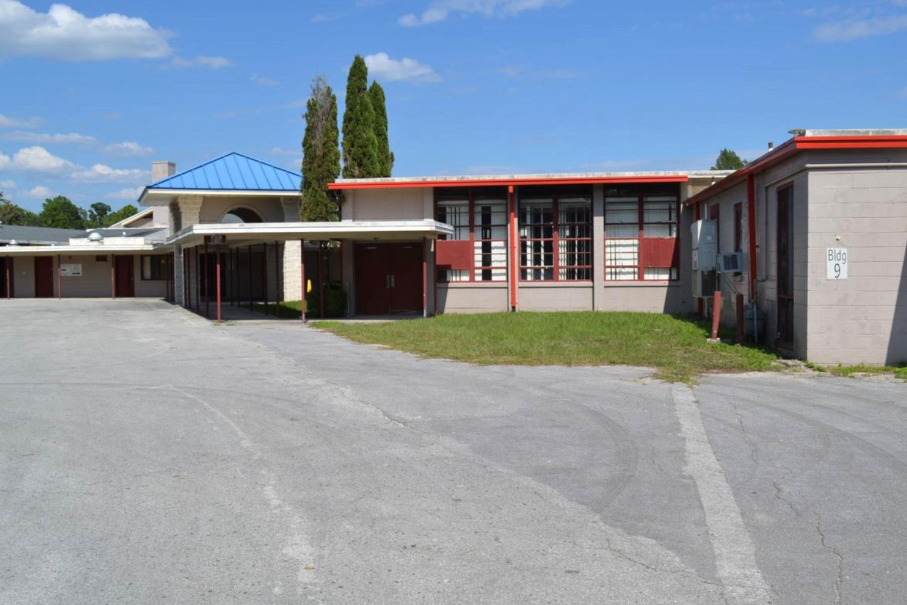
A Trip Down Memory Lane

Slide 12
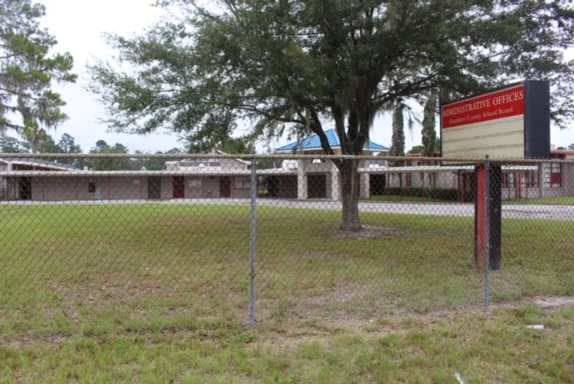
A Trip Down Memory Lane

Slide 13
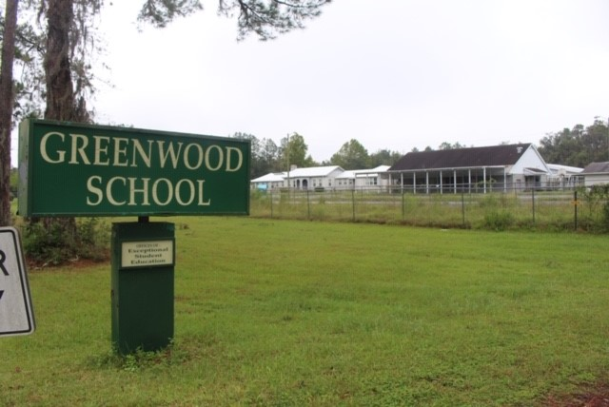
A Trip Down Memory Lane

Slide 14
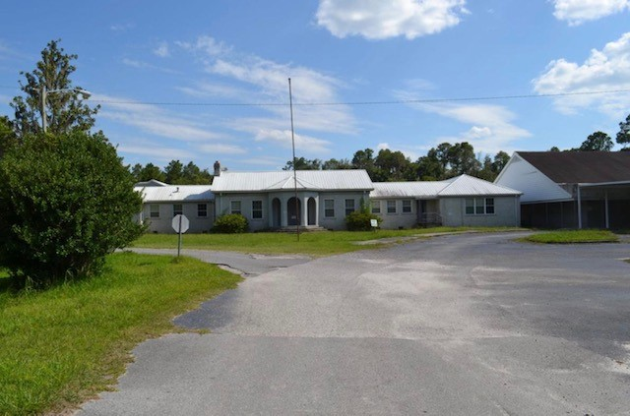
A Trip Down Memory Lane

Slide 15
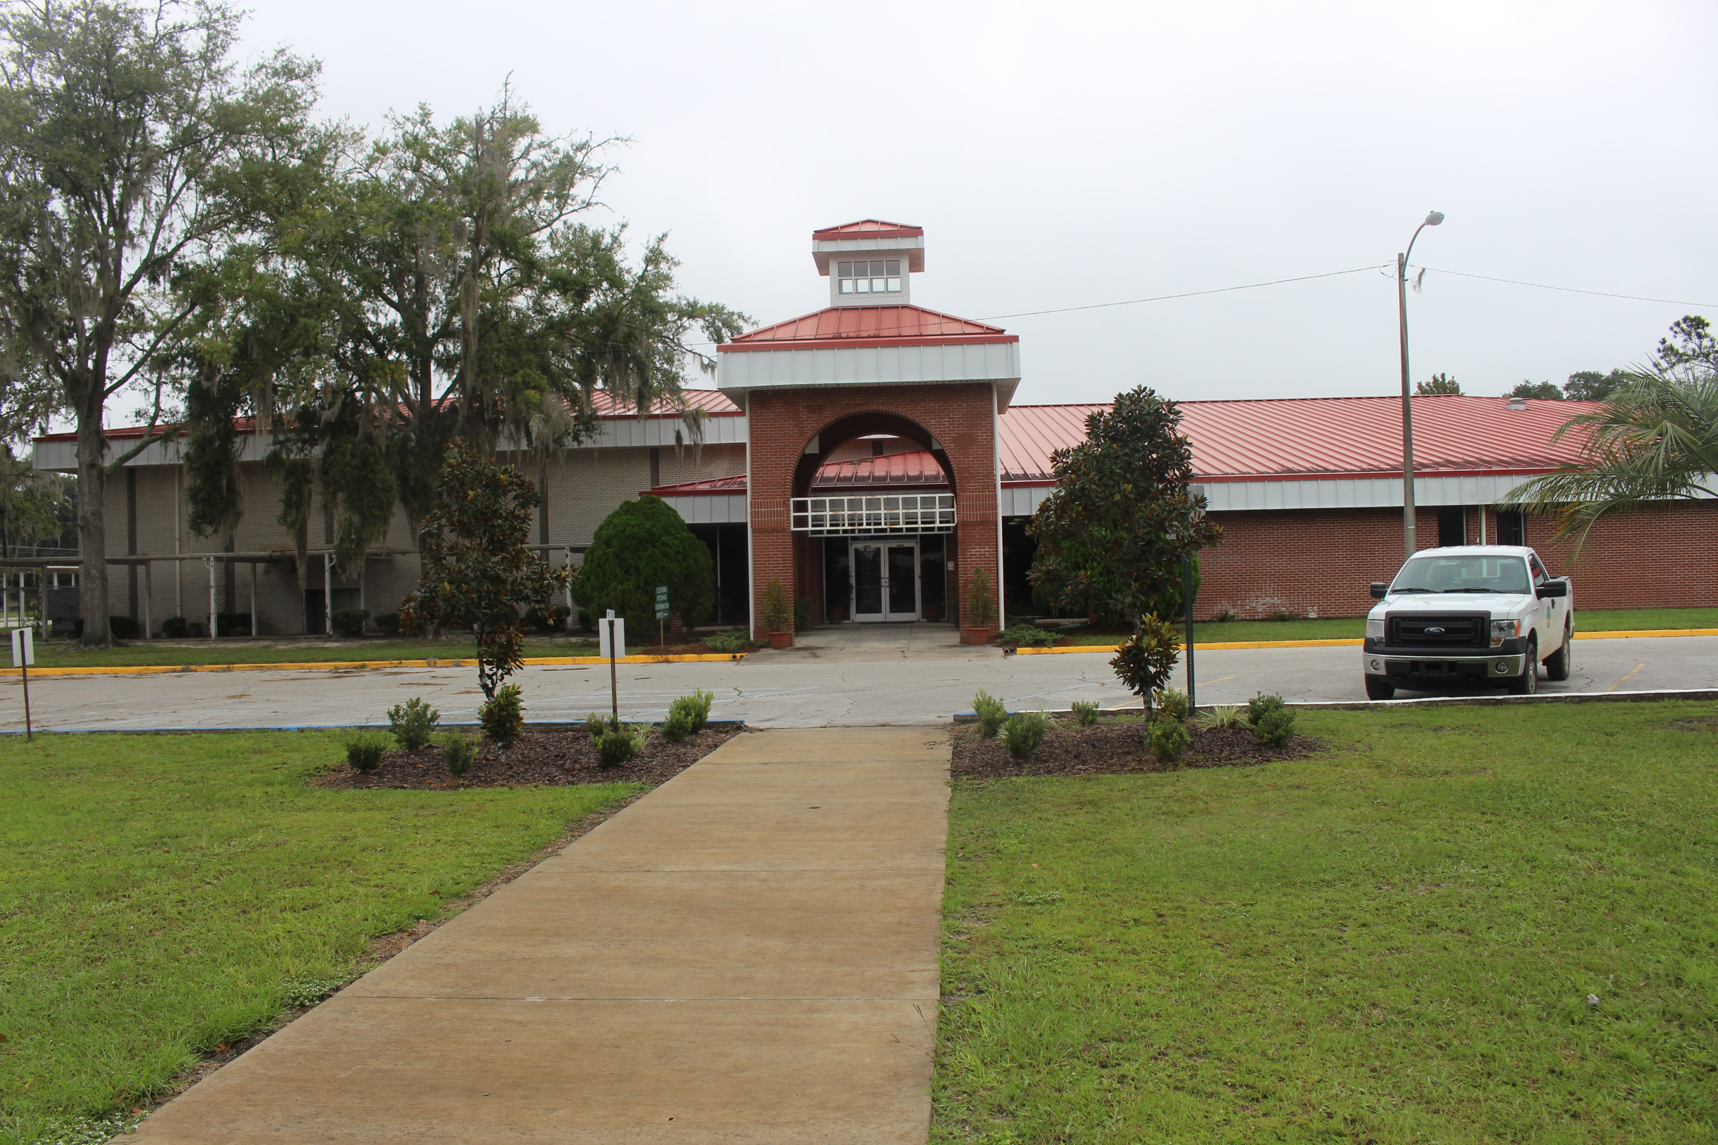
A Trip Down Memory Lane

Slide 16
A Trip Down Memory Lane

Slide 17
The Importance of Building Relationships
“I have learned that people will forget what you said and will forget what you did, but people will never forget how you made them feel”
-Maya Angelou

Slide 18
Guess What?
“Life is 10% what happens to you and 90% how you react to it”
-Charles Swindoll

Slide 19
Never Give Up
“Success is not final; failure is not fatal; it is the courage to continue that counts” -Winston Churchill

Slide 20
Learning from Mistakes
“The person who really thinks will learn as much from his failure as from his success.”
-John Dewey

Slide 21
Great Advice!
“Be thankful for what you have and you will end up having more. If you concentrate on what you don’t have, you will never, ever have enough” -Oprah Winfrey

Slide 22
Engagement is Key!
“Student engagement is usually in direct proportion to teacher enthusiasm.”
-@SteeleThoughts

Slide 23
Show Them That You Care
“Teachers who put relationships first don’t just have students for one year; they have students who view them as their teacher for life.” -Justin Tarte

Slide 24
Building Relationships
“You can have high expectations and still be liked by kids.” #teachergoals

Slide 25
The Impact of Teachers
“For everyone of us that succeeds, it’s because there’s somebody there to show us the way out. The light doesn’t always necessarily have to be in your family; for me it was teachers and school.” -Oprah Winfrey

Slide 26
Growth Mindset
“It is important that we not debate what students can or can’t do but instead ask the question: How will we get every learner there?”
-Dr. R. Dufour

Slide 27
Positive Communication
“You can’t call home too often. Taking time out of your schedule to make a simple phone call can make a world of difference. Celebrate the success of children.”

Slide 28
Implementing a Growth Mindset
“For no matter what your ability is, it is effort that ignites that ability and turns it into accomplishment.”
-Carol Dweck

Slide 29
Making a Difference
“Our charge as educators is to guarantee our students a successful future and not leave it in the hands of fate.”
-Dr. Harvey Perkins

Slide 30
Embrace the Mistakes!
“It is important that we encourage students to set their goals high, embrace their mistakes, and not be afraid to fail.”
–Jessica Solano

Slide 31
Keys to Success
“To go from where you are to where you want to be, you have to have a dream, a goal, and be willing to work for it.” @jeffhiseredu

Slide 32
Words of Wisdom
“If everyone is moving forward together, then success takes care of itself” -Henry Ford

Slide 33
“In a world where everything is drab, be the color that sparks a child’s imagination.”

Slide 34
“Let’s Celebrate Soaring Potentials!”

Slide 35
“It does not matter how or where you start but what you do when you finish.” “Never, Never, Never Ever Give Up!”

Slide 36
“You are my beautiful butterfly…I will be by your side from your cocoon until you fly!”

Slide 37
“Be a guiding light for your students so that they may shine.”

Slide 38
“We don’t know the individual burdens or talents that these shoes carry, but we need to work hard to become aware of those things and teach in a way that helps students walk the path to success.”

Slide 39
“I am ready for a new adventure! It is important to know that, in education, the road does not end. We just have to sometimes change the vehicle used to travel.”

Slide 40
“All students have the capacity to learn. You may paddle at the beginning of the school year with short tiny strokes, but as the year progresses and your knowledge increases so will your mind. Build up your growth mindset and the power of being positive.”

Slide 41
“Students will grow and bloom like a flower. The seeds are planted on Day 1, and they will be blooming beautifully on Day 180.”

Slide 42
“It is time for us to make a splash! Yes, really seally!”

Slide 43
“In order to be successful, you must always be hungry for knowledge.”

Slide 44
“I will have control of the wheel that guides students to success. What are you driving?”

Slide 45
“I am ready to plant some ideas. Are you?”

Slide 46
“Clear as water! Clarity is the ability to really get to know our children in order to provide them with the stability of a classroom education that will help them AND me grow.”

Slide 47
“The balloons are soaring high just as our ambition should be high for students and ourselves to succeed.”

Slide 48
“It is important for everyone to work towards a common goal and for everyone to have fun progressing from one standard to a much higher standard.”

Slide 49
“As we reach new heights, it is important for us to feel safe leaving our comfort zone.”

Slide 50
“I really want to help my students visualize themselves celebrating their success at graduation.”

Slide 51
“This picture of cupcakes seems so perfect! In education, we are like cooks. A lot of work and effort goes into baking, and we have to make sure that the exact amount of ingredients are put together to get the perfect rise. As we work hard with our students, we will get the same great results.”

Slide 52
“I hope this school year experience will feel like smooth sailing, and by the end of the year, we will encounter a beautiful ending.”

