Slide 1
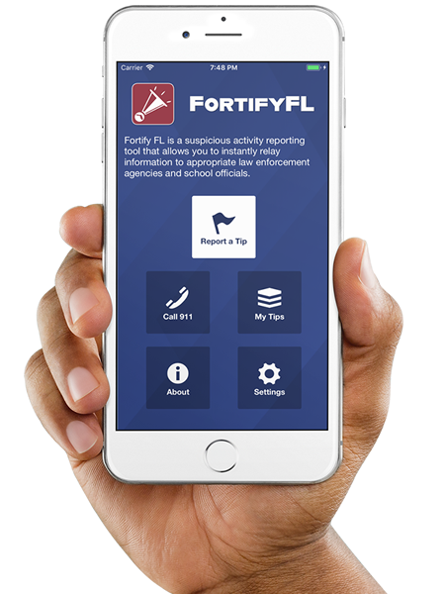
Anonymous Reporting App

Slide 2
ATTENTION STUDENTS!!
Did you know that the Florida Department of Law Enforcement and the Florida Department of Education created an anonymous reporting App that allows you to instantly send information about suspicious activity to local law enforcement and school officials?

Slide 3
WHY?
It is important to always remember that If You See Something, Say Something! With FortifyFL, you can easily submit information about potential crimes or threats which will immediately be forwarded to law enforcement and designated school personnel.

Slide 4
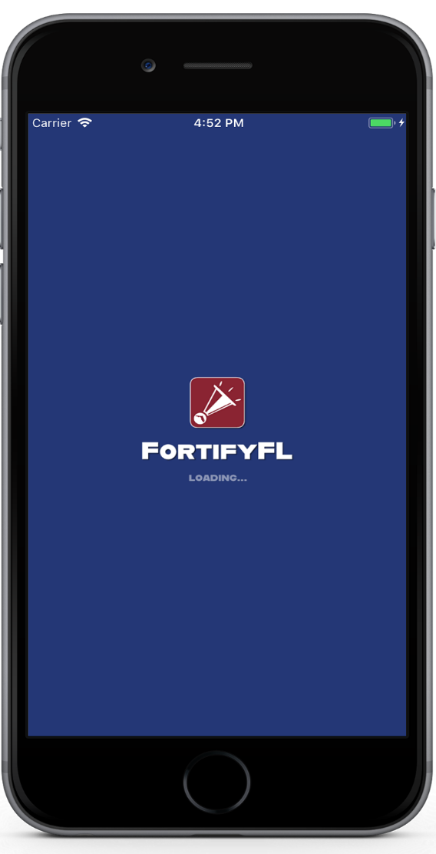
HOW DO I SUBMIT A TIP?
Step 1: Download the FortifyFL App on your mobile device.

Slide 5
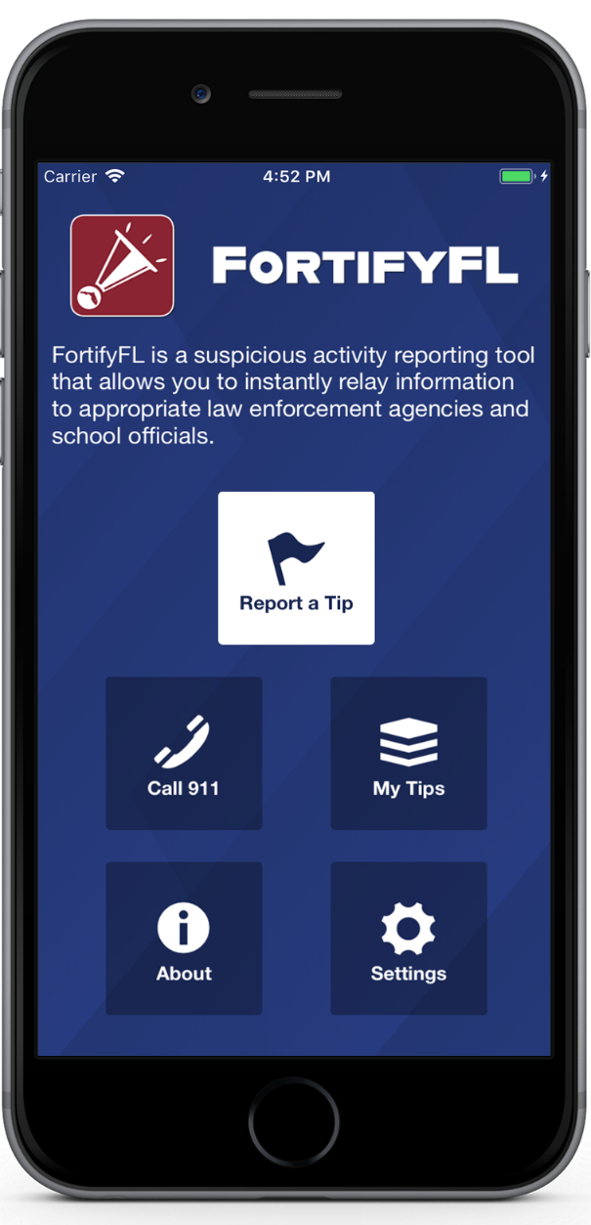
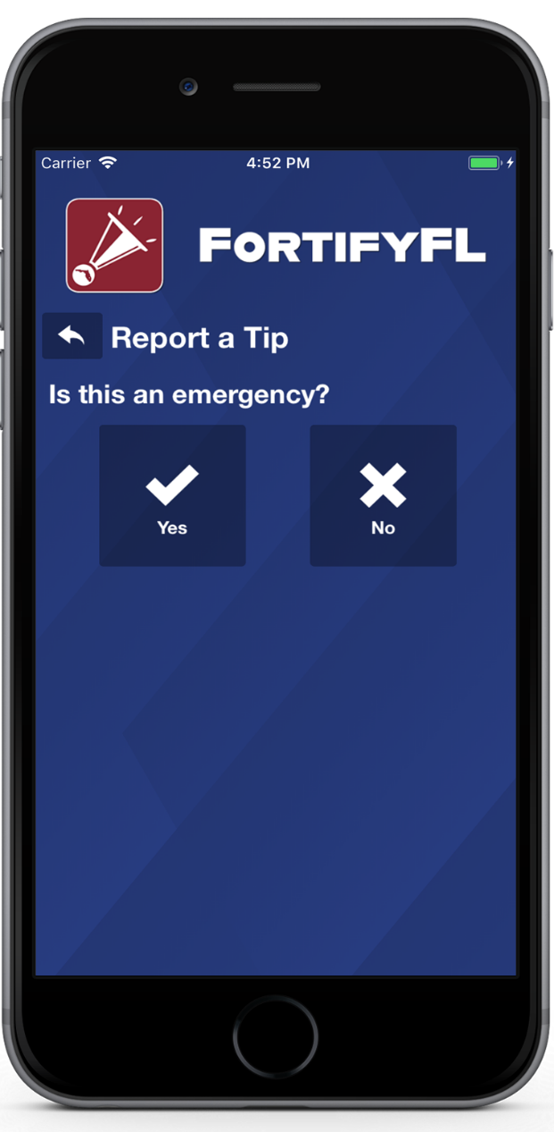
HOW DO I SUBMIT A TIP?
Click “Report a Tip,” and indicate if it is an emergency

Slide 6
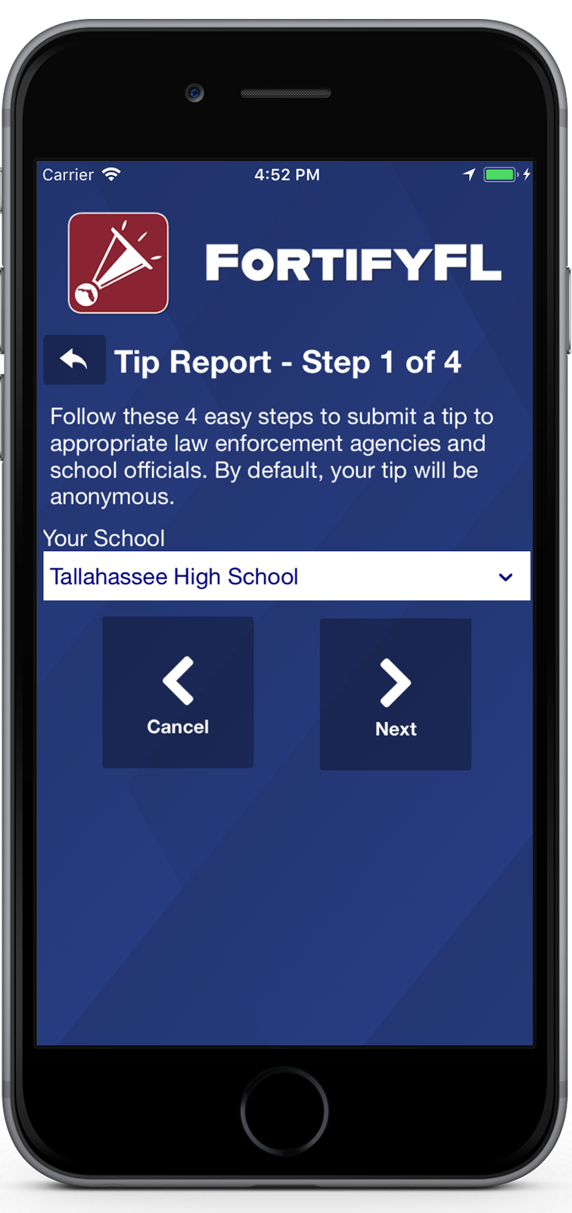
HOW DO I SUBMIT A TIP?
Step 1: Select Your School

Slide 7
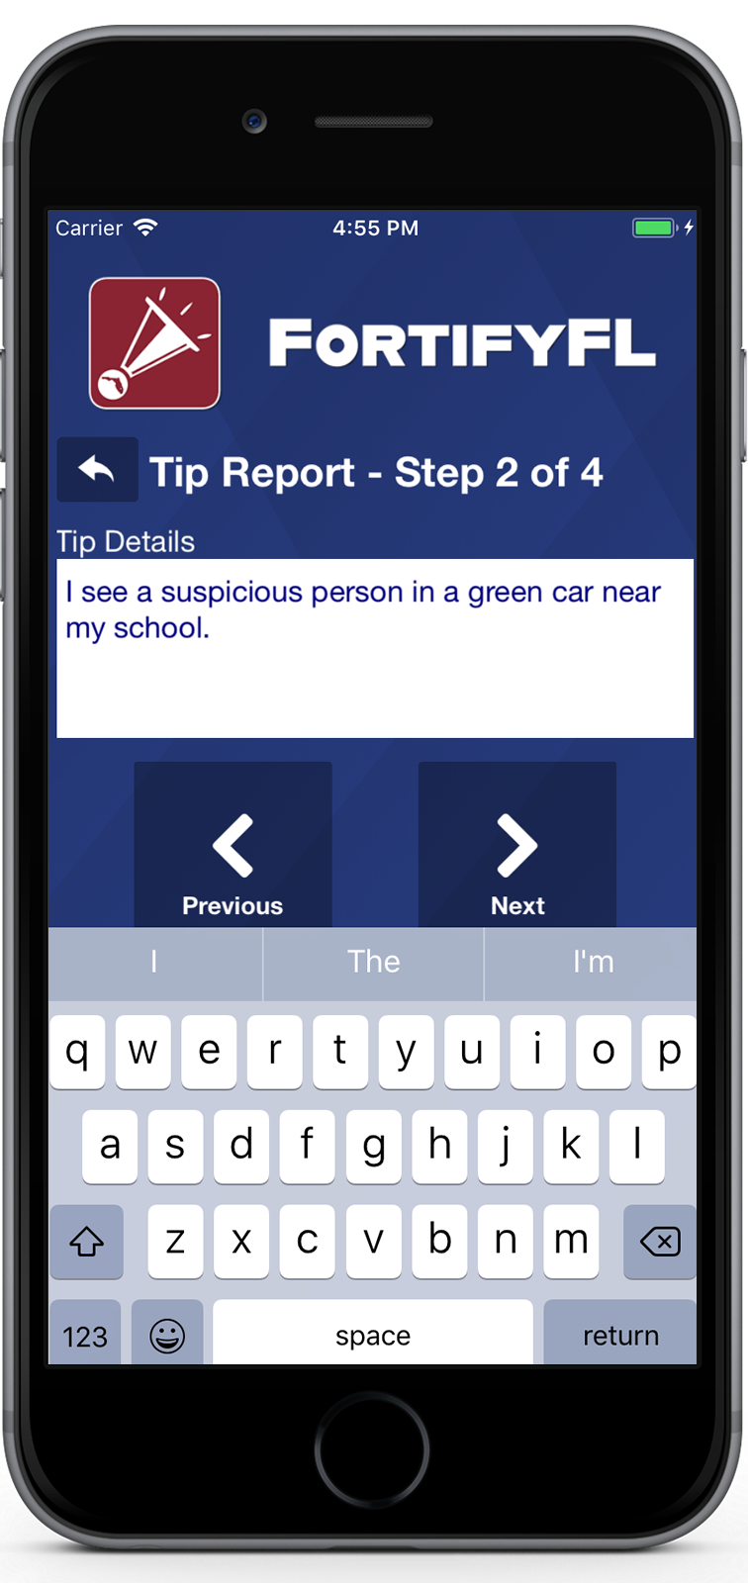
HOW DO I SUBMIT A TIP?
Step 2: Provide Your Tip

Slide 8
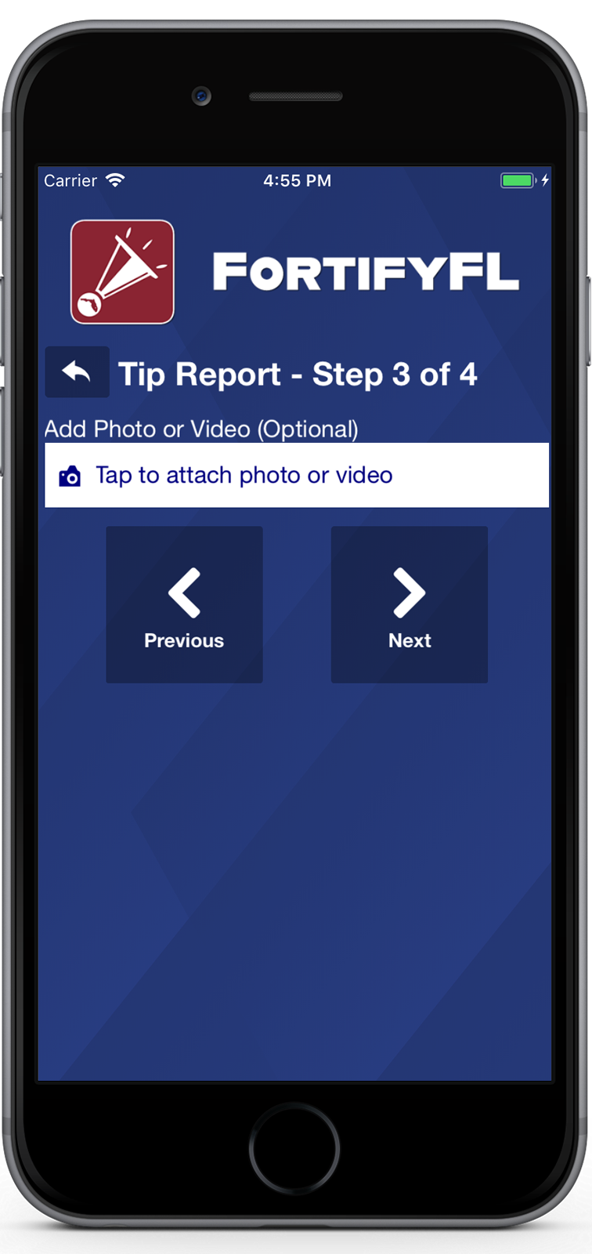
HOW DO I SUBMIT A TIP?
Step 3: Attach an Optional Photo or Video

Slide 9
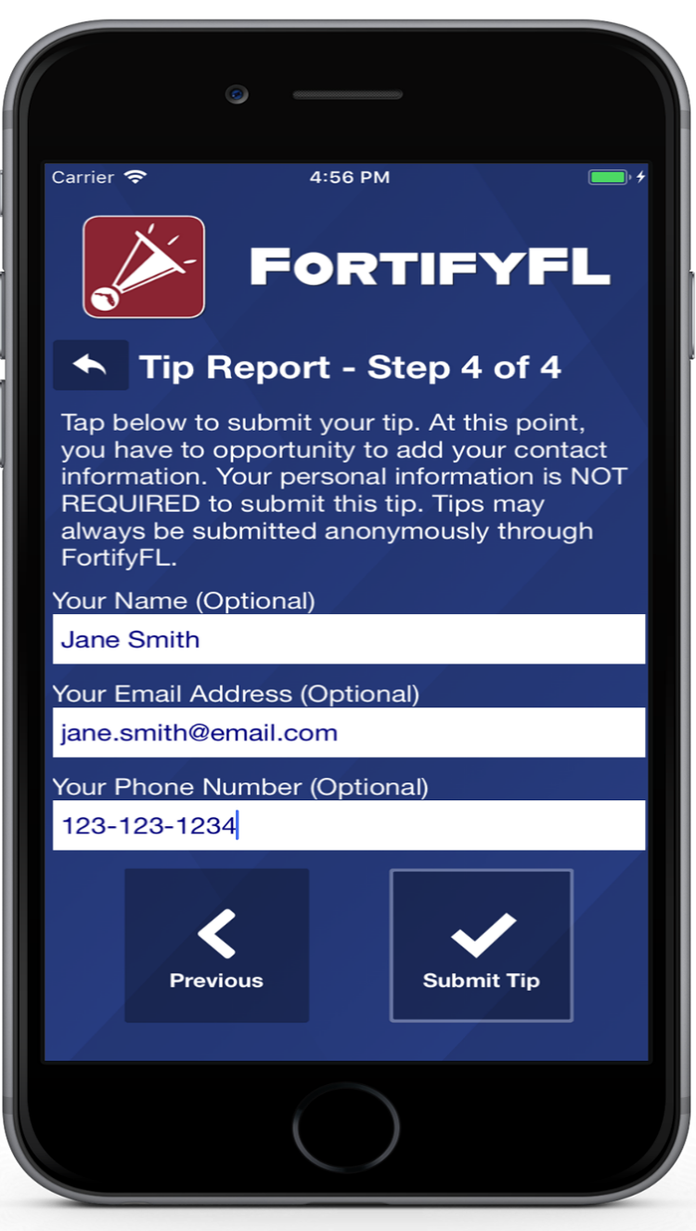
HOW DO I SUBMIT A TIP?
Step 4: Provide Optional Information and Submit Your Tip

Slide 10
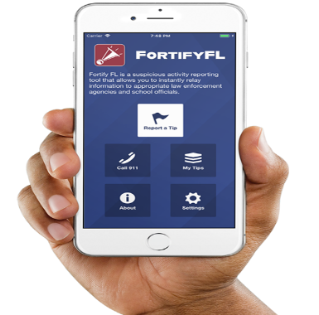
Thank you for being proactive and for helping to keep our school and community a safer place!

